Slide 1

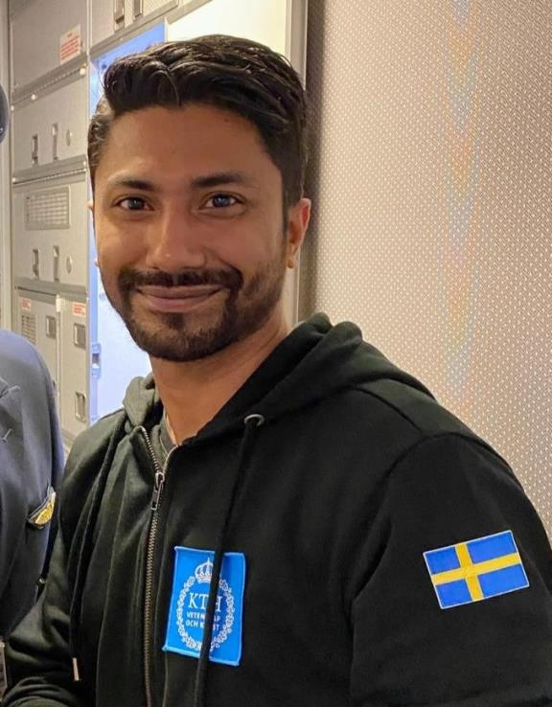
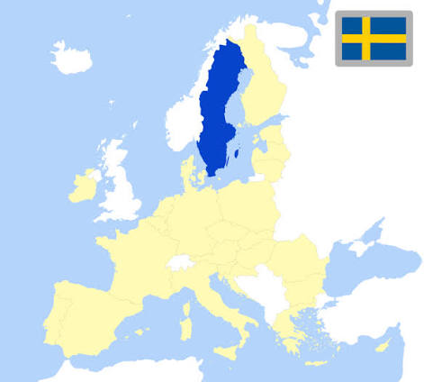




Md Hasib Mahmud Rabby
University: KTH Royal Institute of Technology
Study program: Embedded Systems
Year of study: Graduate
City: Stockholm, Sweden
Motto for life: Stay curious, keep learning, and turn every experience into something meaningful.
Hobbies: I enjoy anything that allows me to explore, create, or capture a moment.
Your expectations from the summer school: Learn from experts. Exchange ideas with peers. Discover a new culture. Build connections that last beyond the summer school.
Location:
where I studied,
and I live
Karlsruhe
31 August to 11 September 2026

